Slide 1

Pressure Prediction by a Convolutional Neural Net
Jacob Child

Slide 2
Motivation
Clearly defines the problem, provides context, and explains significance.
Particle Image Velocimetry- An experimental method that returns velocity fields, and pressure fields can only be predicted through estimating boundary conditions and then using computationally expensive numerical methods
Super-resolution and denoising of fluid flow using physics-informed convolutional neural networks without high-resolution labels (The HW 8 Paper) –

Slide 3
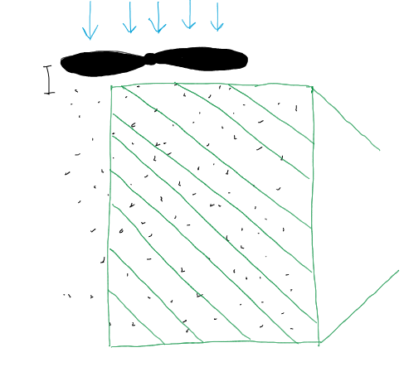
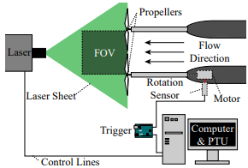

Particle Image Velocimetry
A laser sheet is shined through a particle laden flow
Two highspeed images are taken in quick succession
A computer is used to track the particle movement and create a velocity field
No pressure data
Used with permission

Slide 4
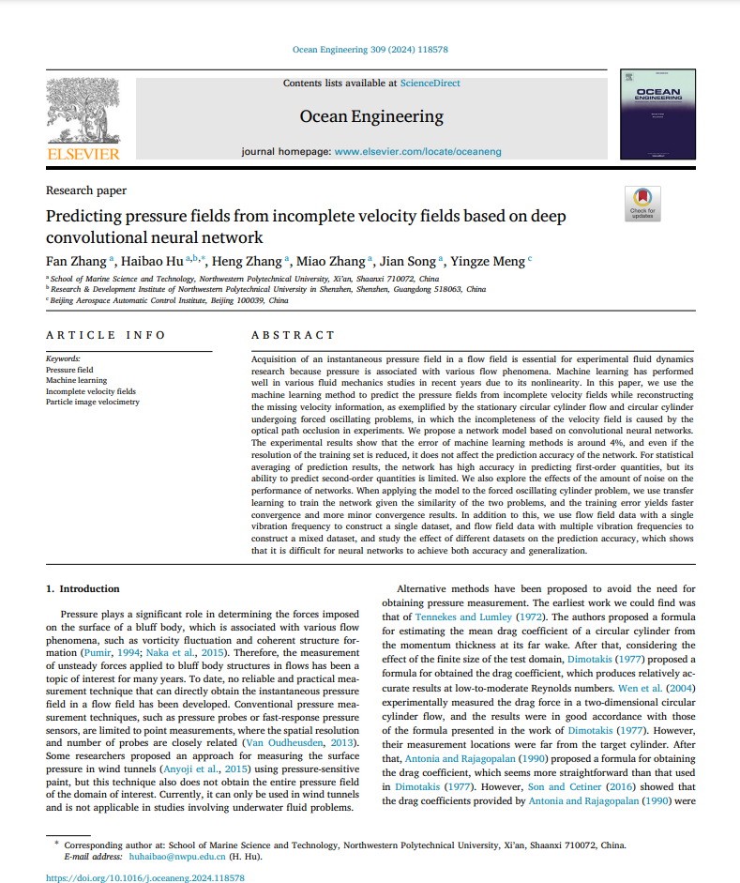
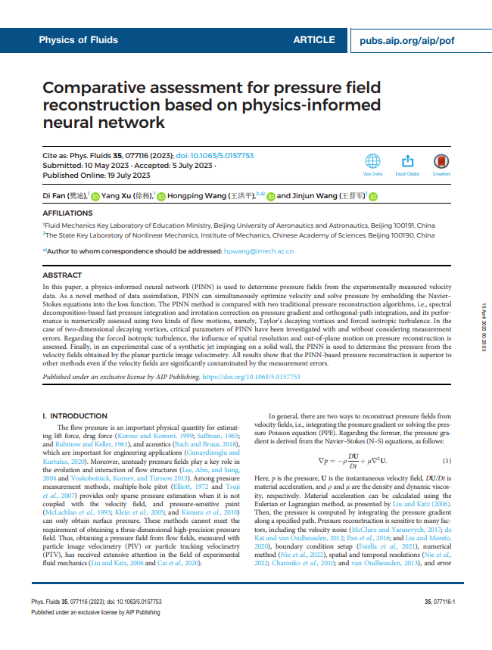



Relevant Literature
ResearchRabbit suggested paper collection (not curated)

Slide 5
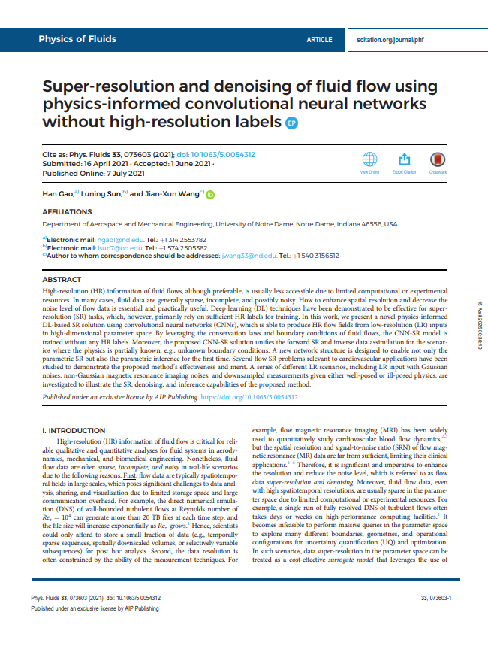

Approach: Vascular Flow (done in class)
Convolutional Neural Net to upscale x and y components of velocity, also predict a pressure field
Governing Equations: x and y momentum from 2D Navier-Stokes, continuity from 2D Navier Stokes
Incorrect pressure field
“The current framework cannot accurately recover the hidden pressure field because of the implicit coupling of pressure and velocity (i.e., the pressure appears as a source term in the momentum equations). The governing equation needs to be reformulated to strongly couple the pressure and velocity predictions based on, e.g., elliptic equation of pressure 81 and Rhie–Chow interpolation.75”

Slide 6
Methods
Uses appropriate methods and best practices. Explains approach with technical rigor (e.g., model architecture, loss functions, training details).

Slide 7
Methods
Convolutional Neural Net: Good for spatially correlated data (flow fields)
Activation Function: ReLU
Layer Channels: 2 (input) -> 16 -> 32 -> 64 -> 32 -> 3 (output)
Kernel Size: 5x5
Padding: 2
Learning Rate: 1e-3, or 1e-4
Copied and modified the paper slightly- produced satisfactory results

Slide 8
Layout
Super-resolution: upscale and predict u, v, p
Super-resolution: give the upscaled data and predict p
PIV Side-View Dataset: predict p
PIV Wake-View Dataset: predict p

Slide 9

Super-Resolution
Predicting: u, v, p
Enforced Boundary Conditions
Code

Slide 10
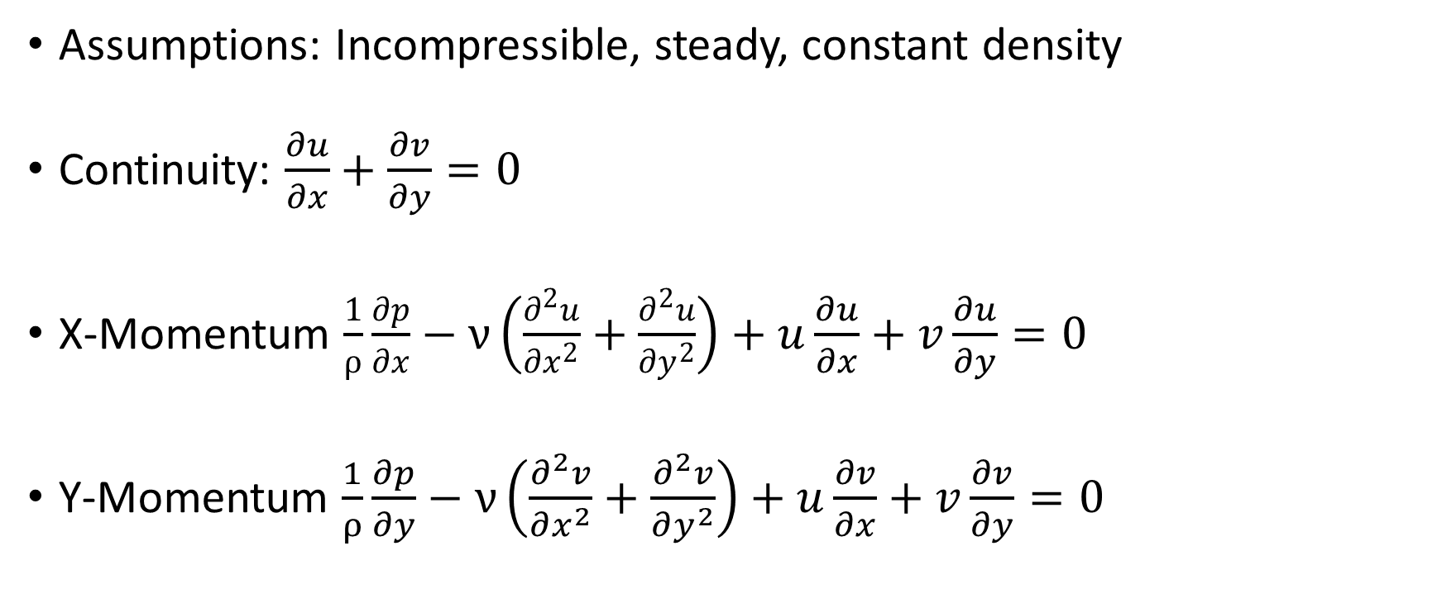
Loss Functions (Super-resolution for u, v, p)
Assumptions: Incompressible, steady, constant density
Continuity: $\frac{∂u}{∂x}+\frac{∂v}{∂y}=0$
X-Momentum $\frac{1}{ρ}\frac{∂p}{∂x}−ν\left(\frac{∂^{2}u}{∂x^{2}}+\frac{∂^{2}u}{∂y^{2}}\right)+u\frac{∂u}{∂x}+v\frac{∂u}{∂y}=0$
Y-Momentum $\frac{1}{ρ}\frac{∂p}{∂y}−ν\left(\frac{∂^{2}v}{∂x^{2}}+\frac{∂^{2}v}{∂y^{2}}\right)+u\frac{∂v}{∂x}+v\frac{∂v}{∂y}=0$

Slide 11
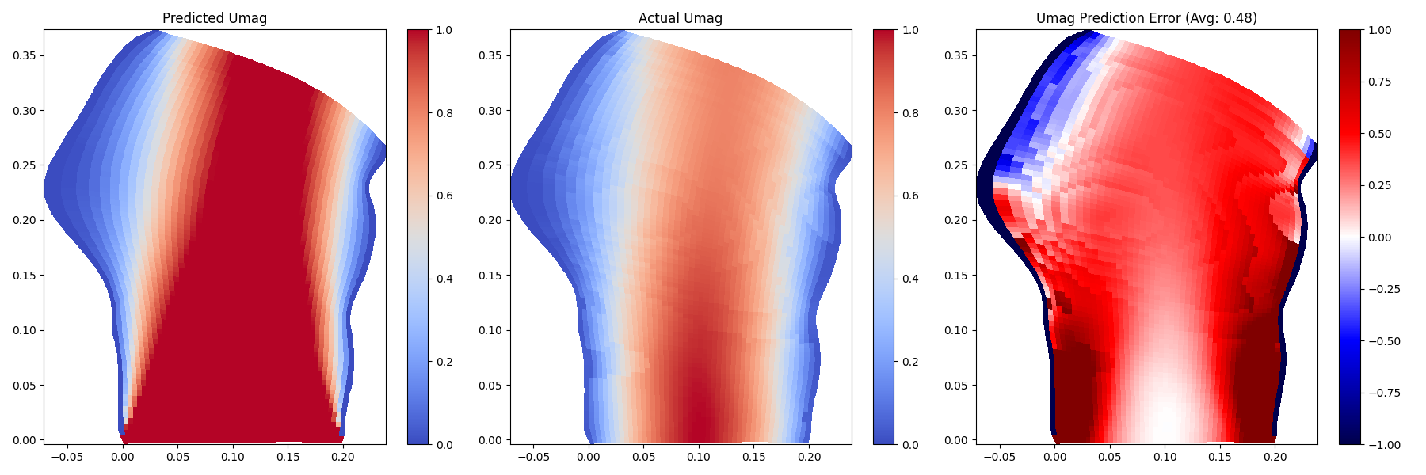
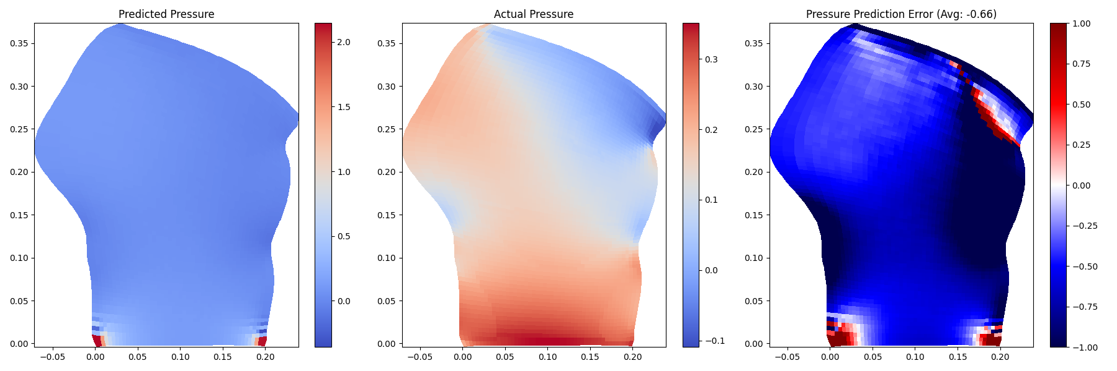
Results
Original, 5000 epochs, no extra pressure term

Slide 12


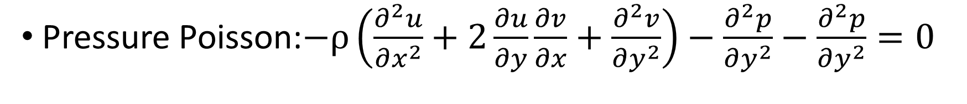
Pressure Poisson (Elliptic Equation of Pressure)
Pressure Poisson:$−ρ\left(\frac{∂^{2}u}{∂x^{2}}+2\frac{∂u}{∂y}\frac{∂v}{∂x}+\frac{∂^{2}v}{∂y^{2}}\right)−\frac{∂^{2}p}{∂y^{2}}−\frac{∂^{2}p}{∂y^{2}}=0$
Wikipedia: Pressure Poisson
Barba Group: Code Application

Slide 13
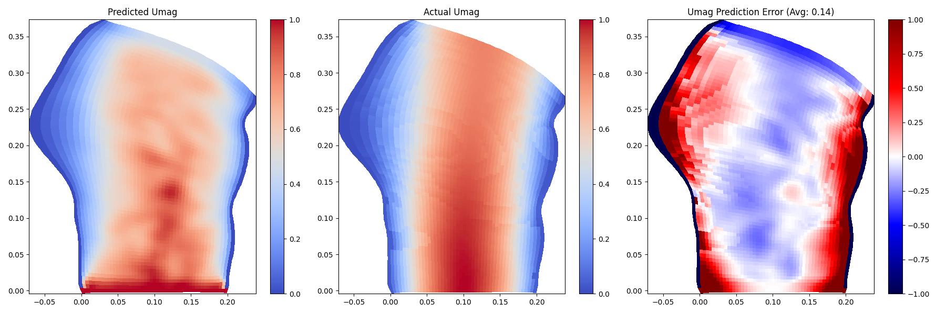
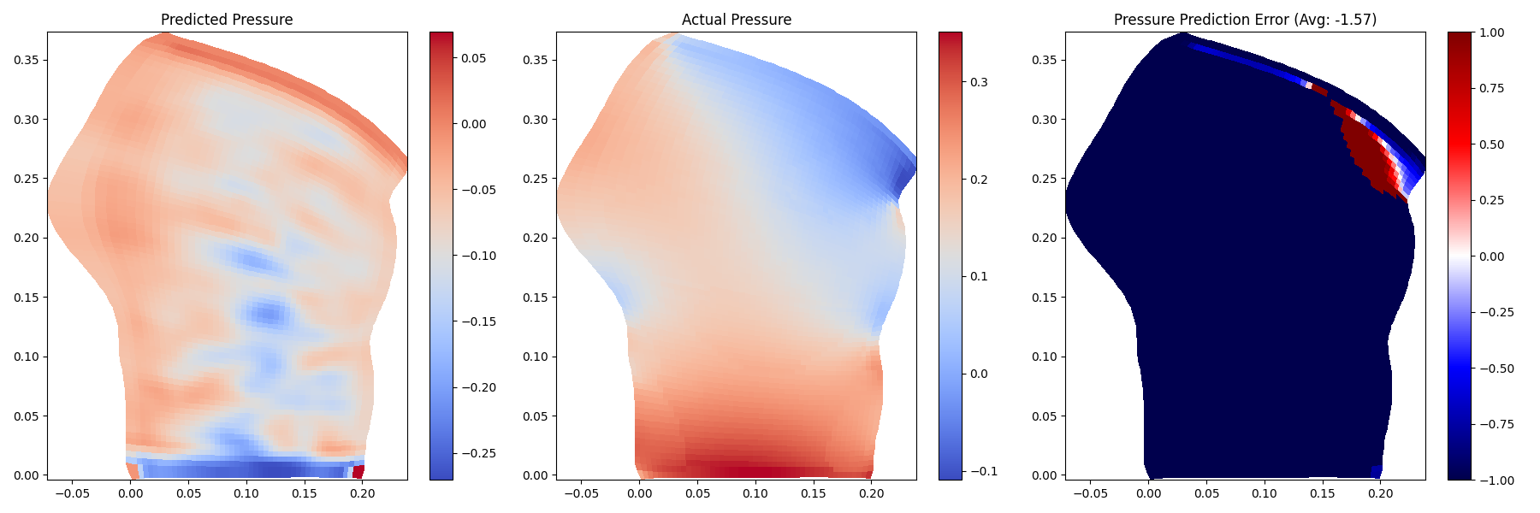
Results
Original, 10000 epochs, pressure poisson

Slide 14

Super-Resolution
Predicting: p
No Boundary Conditions
Code

Slide 15
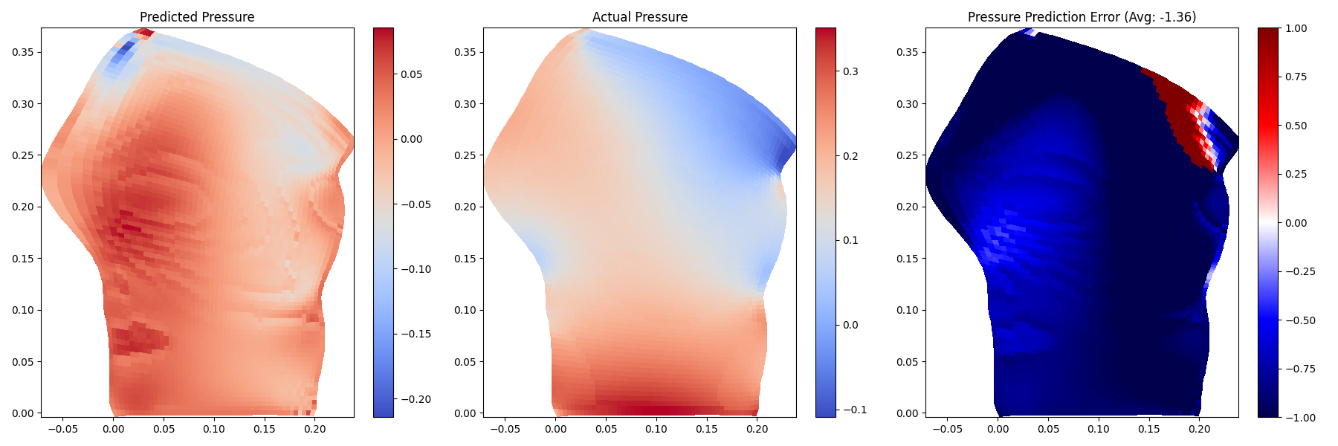
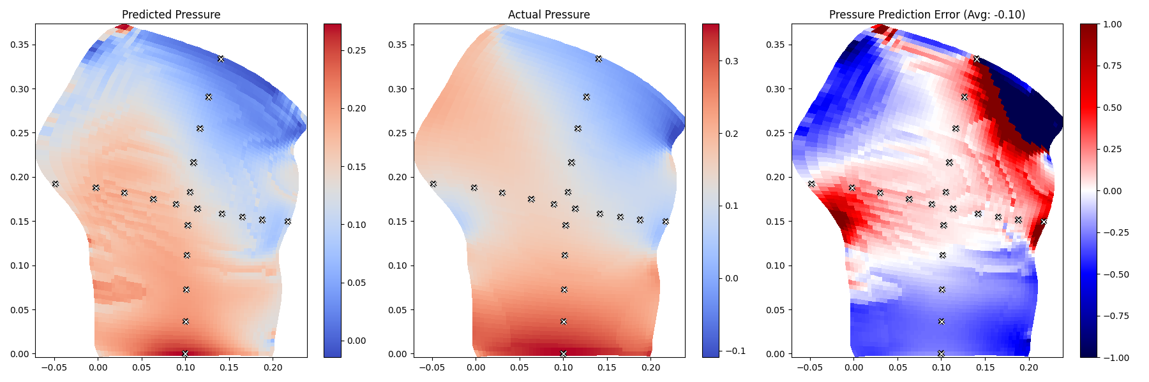
Results
5000 epochs, pressure poisson
5000 epochs, pressure poisson, “pitot data”

Slide 16
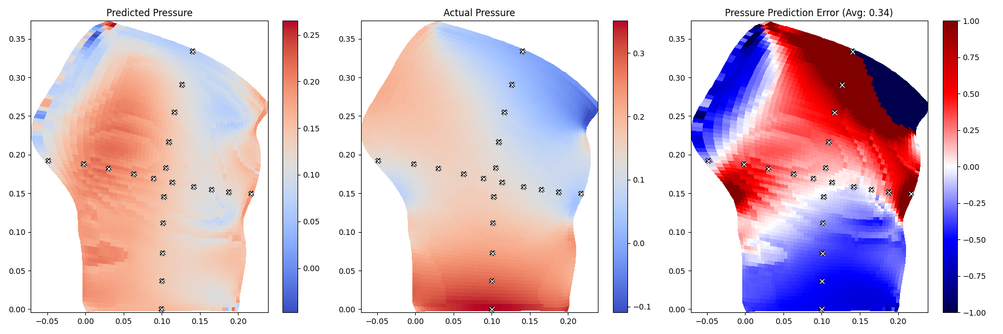
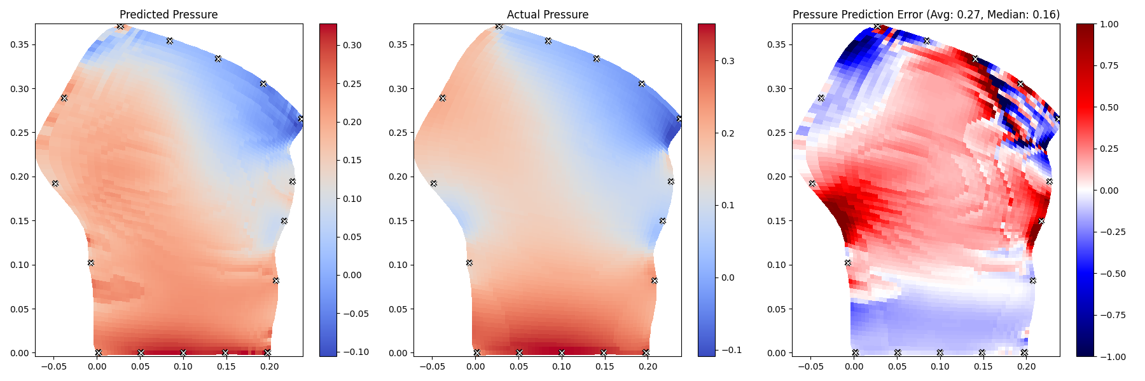
Results
10000 epochs, pressure poisson , “pitot data”
10000 epochs, pressure poisson, “pitot data” on the boundaries

Slide 17

PIV Side-View
Predicting: p
Code

Slide 18
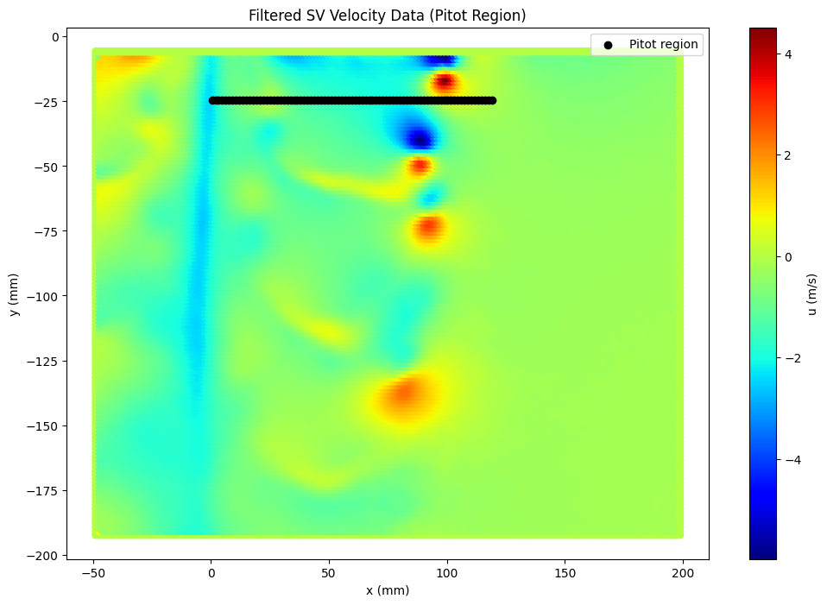
Input

Slide 19
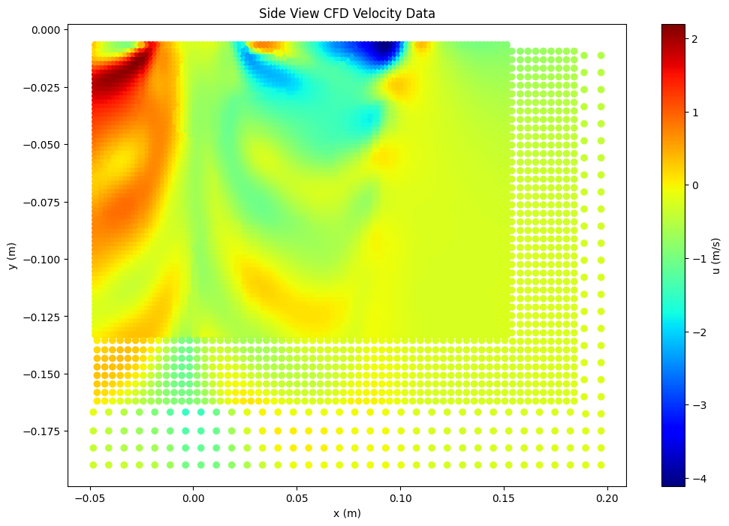
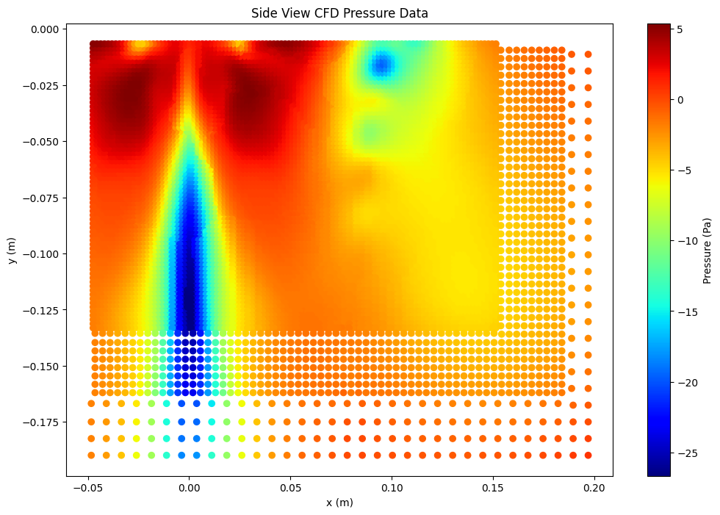
CFD Comparison data

Slide 20
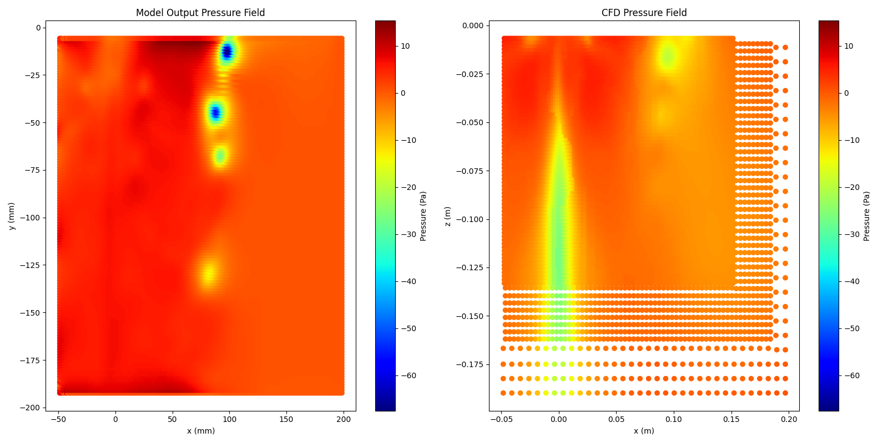
Results
5000 epochs, pressure poisson , pitot data

Slide 21
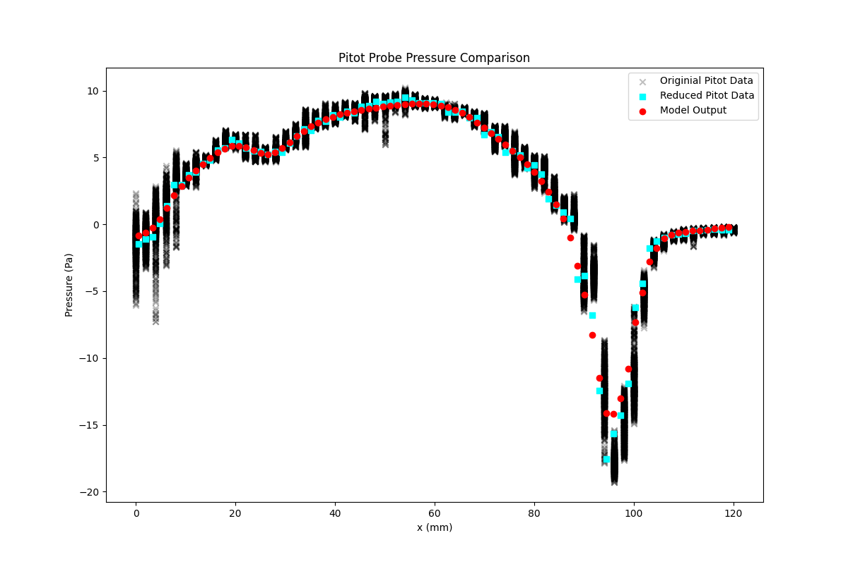
Results
5000 epochs, pressure poisson , pitot data

Slide 22
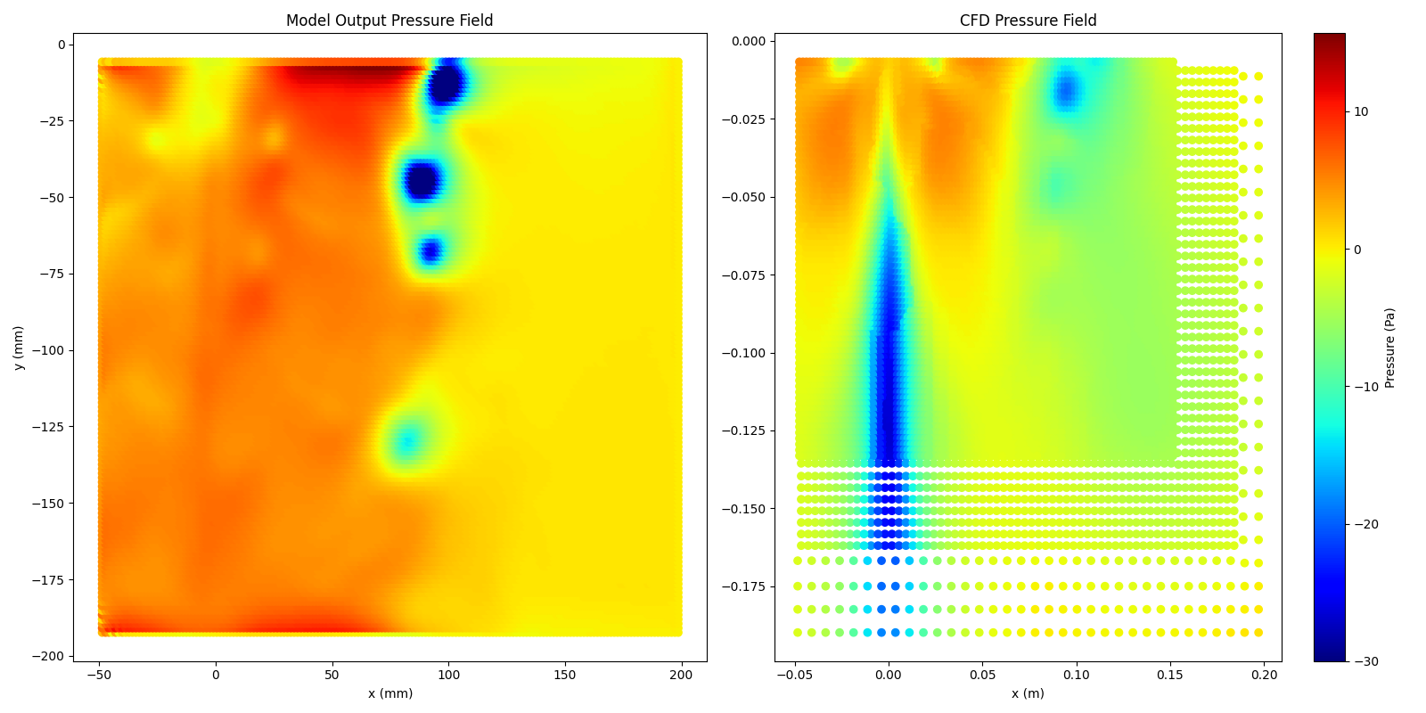
Results
Big Model: Double the number of channels for each layer

Slide 23
PIV Wake-View
Predicting: p
Code

Slide 24
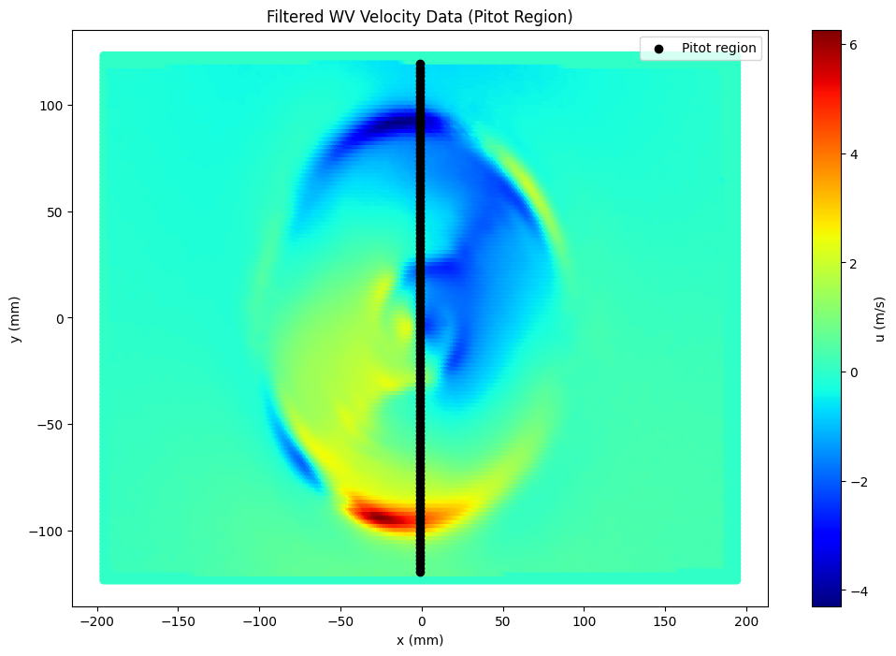
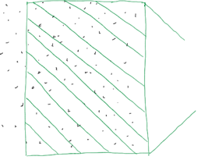
Input

Slide 25
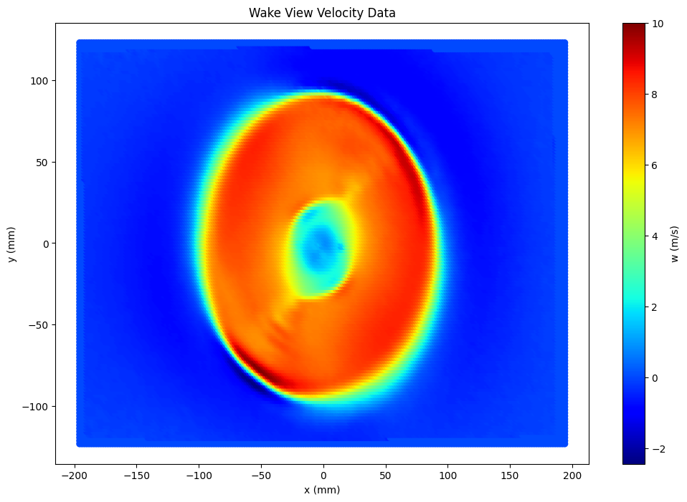
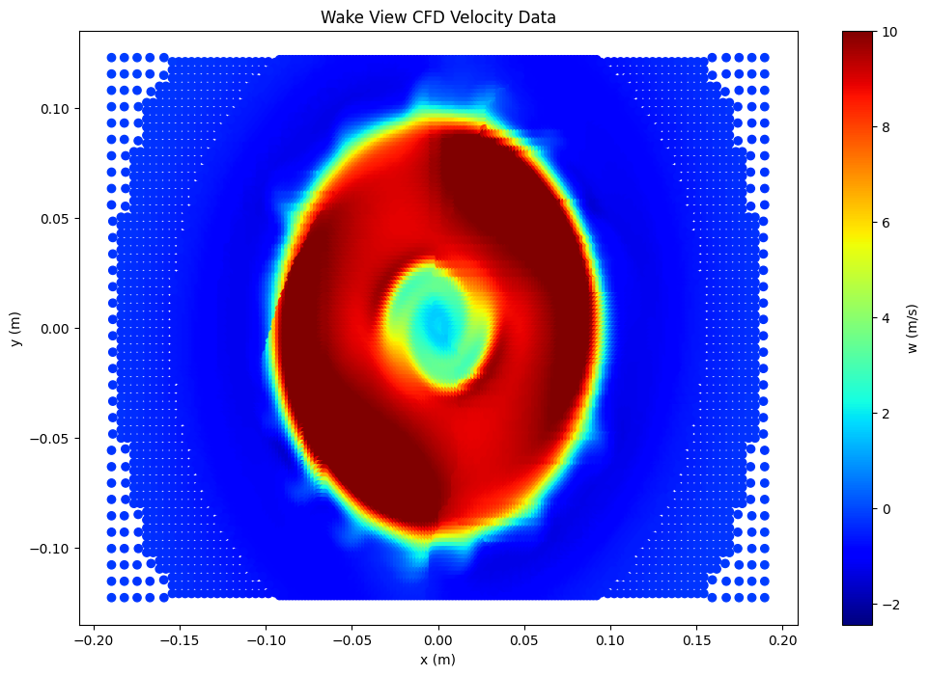
Z-Component of Velocity (w)

Slide 26
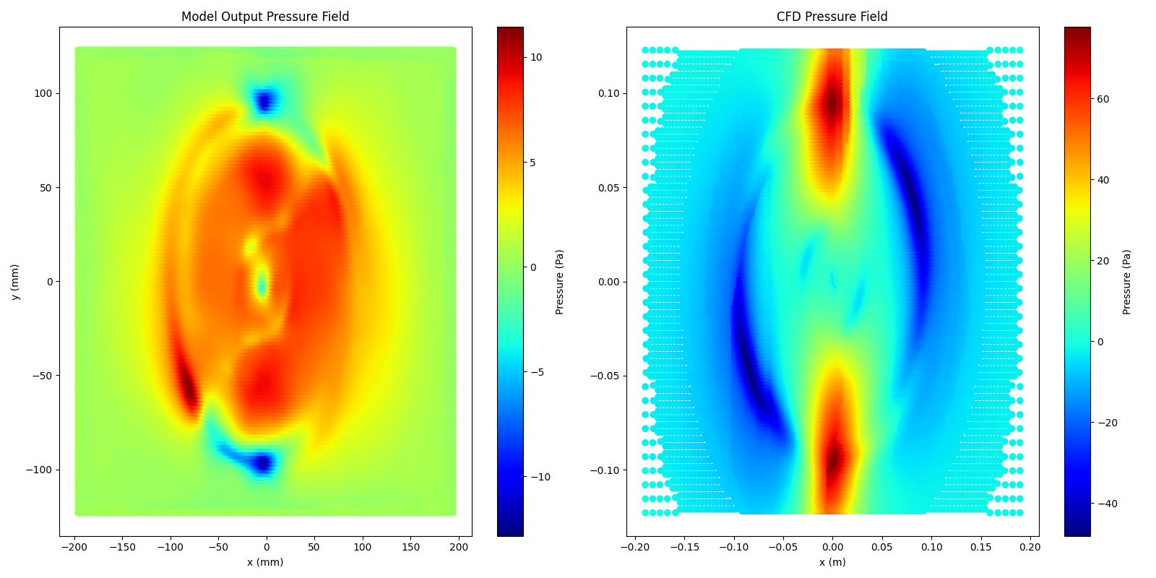
Results
5000 epochs, pressure poisson , pitot data

Slide 27
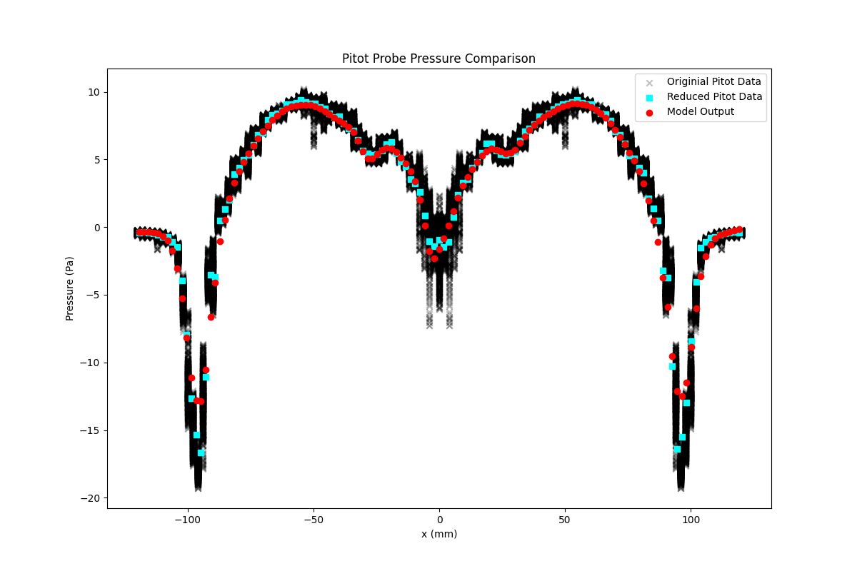
Results
5000 epochs, pressure poisson , pitot data

Slide 28
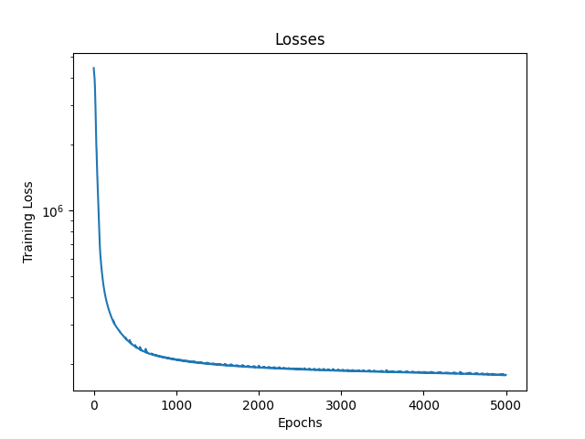
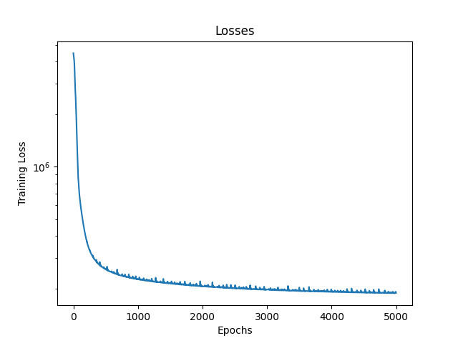
Results
5000 epochs, pressure poisson , pitot data
u, v, w
u, v

Slide 29
Conclusions
It is possible to create a semi-accurate pressure field using a physics informed convolutional neural net
Pressure requires some reference value “pitot data”
Boundary values/conditions are more influential than mid-field values
Tip vortices are captured well in the side-view predicted pressure field
The side-view predicted pressure field matches cfd in form but is off in magnitude
The wake-view predicted pressure field is assisted by the Z-component of velocity

Slide 30
Improvements/Future Work
Pitot Probe pressure data is time averaged, PIV is largely unsteady and CFD is unsteady
For the full benefit of the Z-Component of velocity two Z-planes of PIV data are necessary for derivatives in the z direction
Phase/Tip Vortex mismatch for Wake-View PIV and CFD data
Use the same process on the CFD u, v, w data to further verify the model

Slide 31


Acknowledgments
Dr. Andrew Ning: teacher, derivative code, other template code
Nathan Welker: PIV data, understanding
AI: Coding assistance

